Slide 1
Cyclistic Bike-Share
How Does a Bike-Share Navigate Speedy Success?
Kiane Julius Gaveria

Slide 2
About the Project
Our customer base are rapidly growing attributed to the strong positive customer sentiments and accessibility of our services across the city. Future profitability opportunities are the further expansion of our annual members captured from existing casual members.
Data-driven recommendations answers the difference between annual and casual subscribers and the marketing case for our casual base to upgrade their plans.

Slide 3
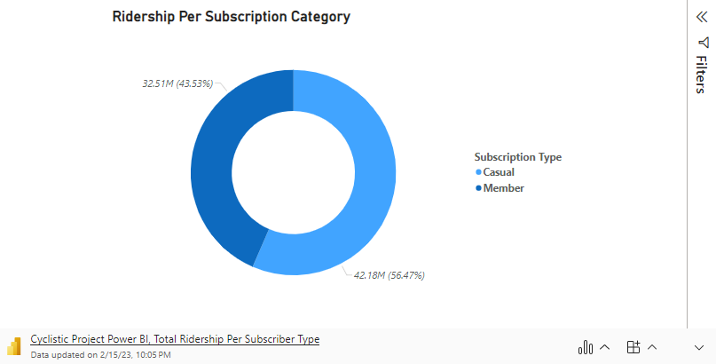
2022 annual members captures only 43% of the total journeys, allowing Cyclistic to have an aggressive push for marketing that segment.
Weekends tend to be Casual-centric by around 65%, while working days tend to have a split between the two. Can be attributed to the working commuters choosing Cyclistic as their primary mode of transportation.
Marketing strategies could put an emphasis on driving in-app advertisements during weekends. Additionally, campaigns could signal towards cost-effectiveness under the annual plan.

Slide 4
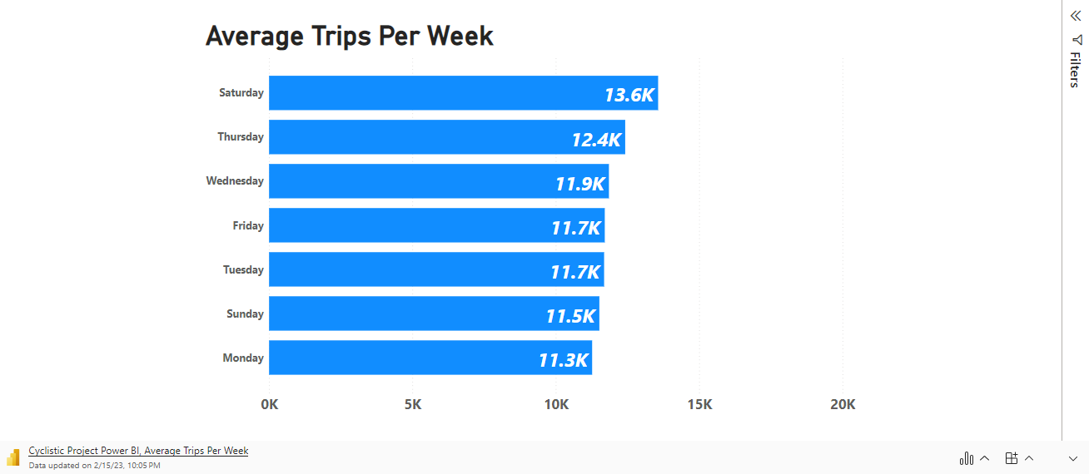
Saturdays are leading with average trips, but for annual members the weekends are lagging.

Slide 5
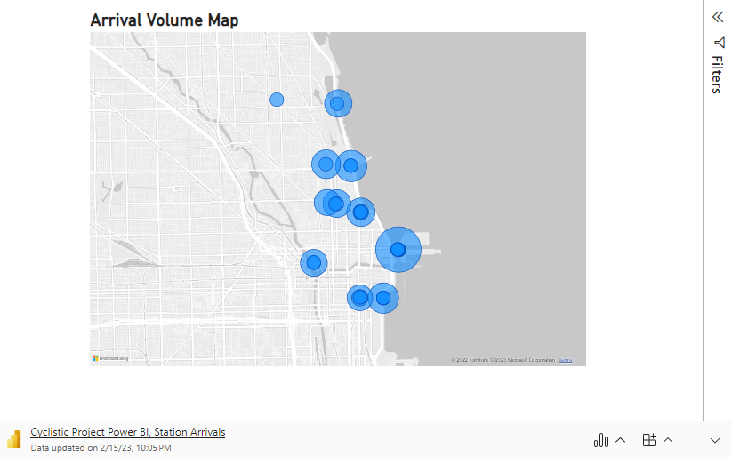
Northern and Downtown Chicago Loop as an arrival hotspot, Casual riders are more prominent in recreational places.
Annual members tend to arrive at the Northern Loop area, as well as the south side of downtown, where various universities and residential areas are located, except Saturdays.
Casual members, on average, consistently arrive around the downtown region near the Lake Michigan.

Slide 6
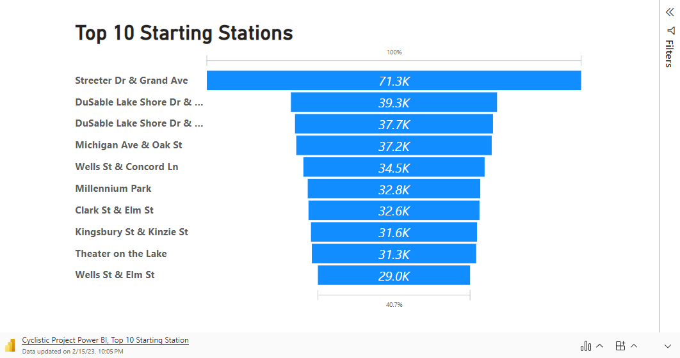
Northern and Downtown Chicago Loop as an arrival hotspot, Casual riders are more prominent in recreational places.

Slide 7
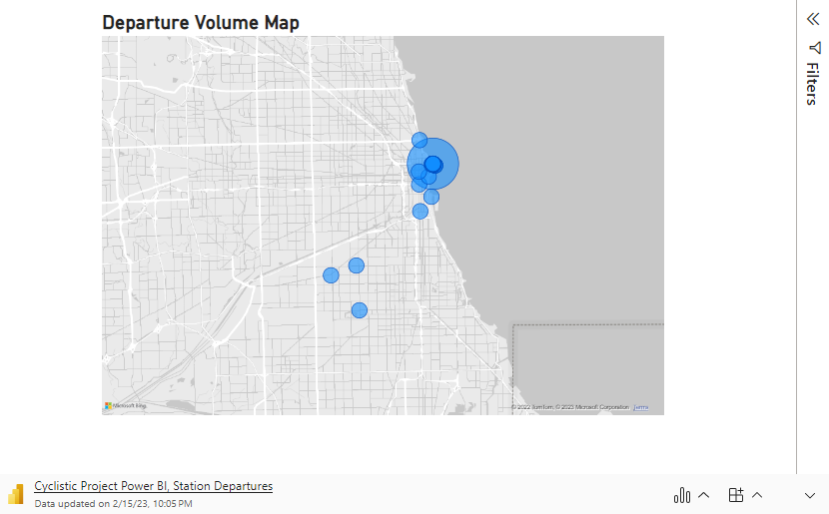
Casual departures are also significant at the residential suburbs outside
With the same correlation with arrivals, departure stations are also spread out outside the downtown core.
Casual riders at the suburban borders can be an opportunity for future annual membership capture.

Slide 8
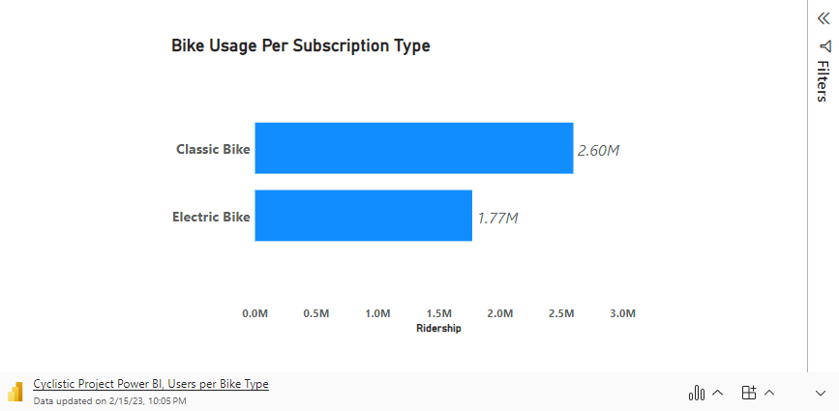
Casual departures are also significant at the residential suburbs outside,
Upon filtering through the type of bikes used, casual riders have equal preferences. Members are skewed towards classic bikes by over 50%.
Overall preference of classic bikes are consistent, on average, throughout the week.

Slide 9
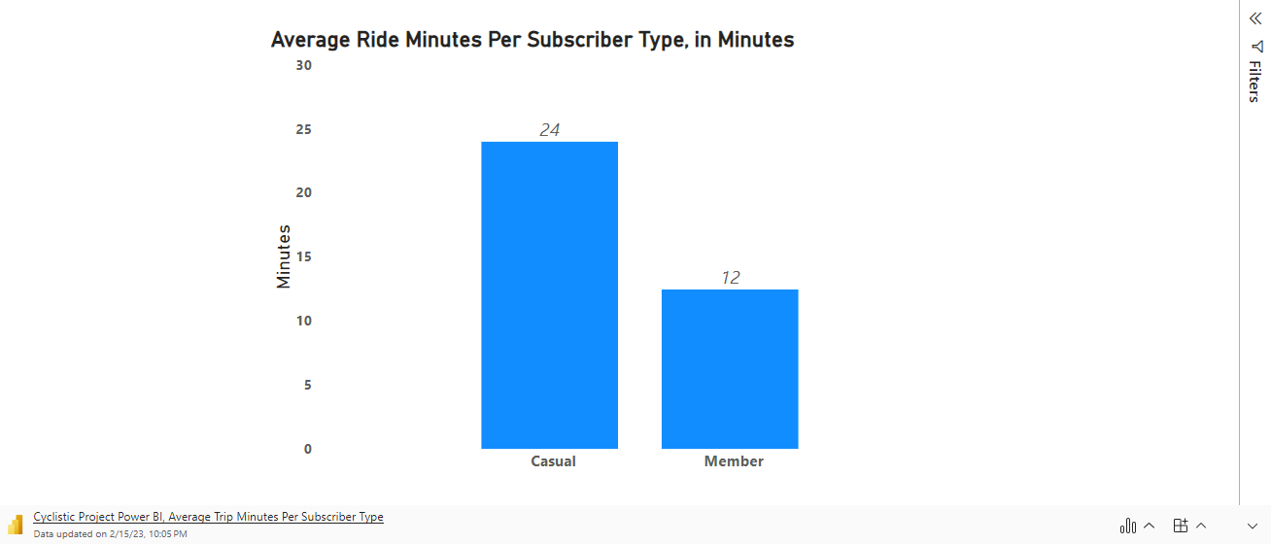
Casual riders spending more minutes creates for a strong business case for marketing campaigns advocating for annual plans as more cost-effective.

Slide 10
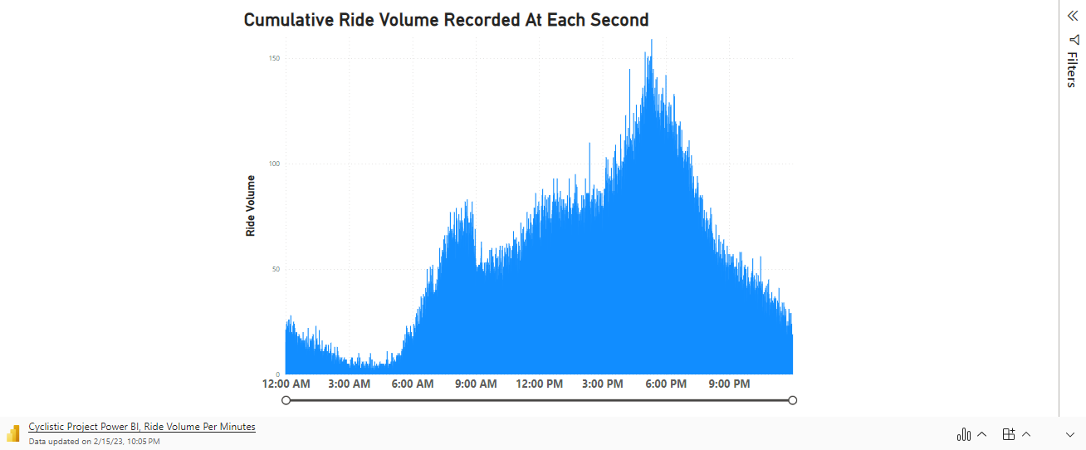
Ride distribution throughout the day were consistent. Weekdays tend to gain riders during afternoon rush hours. Weekend peaks are found at 12PM and slowly subsides.

Slide 11
Recommendations
Strategize promotional materials centering around the cost-effectiveness of annual plans.
In-app marketing campaigns should be more prominent during the weekends.
Release first-time annual discounts at the casual riders arriving and departing at the strip of stations lining the Lake Michigan.
Invest more on the stations leading up to the Loop and the Residential area at the south of downtown, preferably for those coming from the suburban centers.
Additionally, increase the docking capacity at the downtown stations to accommodate the afternoon rush hours from office to home.

